Slide 1
Data Use Acceleration and Learning (DUAL)
Sharing what works (and what doesn’t) to achieve digital transformation for data use
Presenter Name
Presenter Title Presenter Affiliation

Slide 2
Advancing digital transformation for data use
The Data Use Acceleration and Learning (DUAL) initiative aims to share what works to achieve digital transformation based on the experiences of five African countries that are digitalizing their health systems.
DUAL is advocating for the inclusion of country learnings on digital tools and approaches within global policies, future interventions, and funding mechanisms.
Photo: PATH/Gabe Bienczycki
Notes:
DUAL is amplifying learnings from five focal countries with support from the Bill & Melinda Gates Foundation.

Slide 3
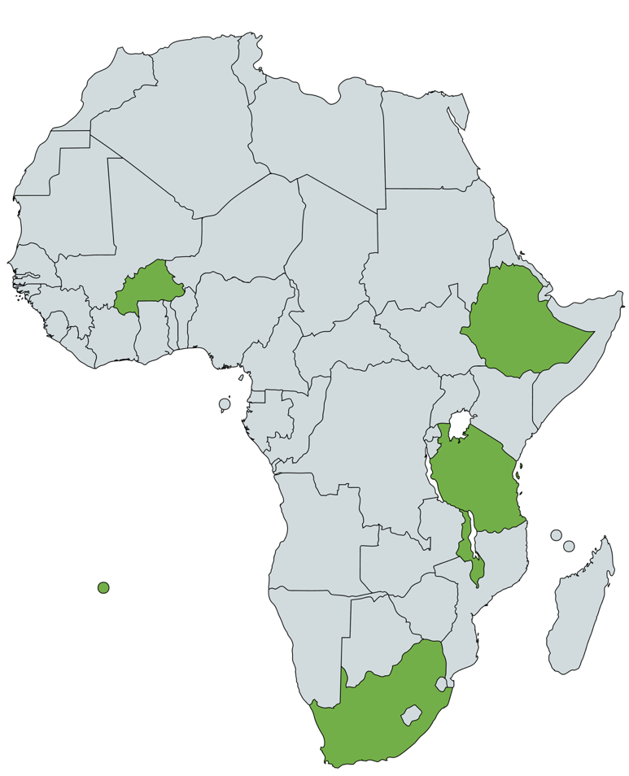
Catalyzing digital transformation for data use
Map depicts 5 focal countries and the partners helping to digitalize the health systems.
DUAL collected learnings from five focal countries and packaged them into a model for digital transformation to accelerate data use.
Burkina Faso
Cooper/Smith
Ethiopia
JSI
Malawi
Cooper/Smith
Tanzania
PATH
South Africa
University of Cape Town
Notes:
These findings were used to design the DUAL model for digital transformation that defines practical, measurable recommendations.

Slide 4
Change objectives
Develop research
framework
Gather
evidence
Develop digital transformation model
Dissemination
and advocacy
Uptake of digital transformation model.
Oct. 2020-Jan. 2021
Conduct desk review and landscape.
Feb.-Aug. 2021
Facilitate interviews and cross-country conversations.
Aug. 2021-Feb. 2022
Develop digital transformation model based on findings.
Feb. 2022-Dec. 2022
Engage and build awareness of model with key stakeholders.
Greater coordination between governments, investors, and implementers.
Stakeholder engagement
Continuous engagement to ensure buy-in and build digital ambassadors
Expert consultation
Technical consultation
Convene advisors
Digital health leaders
Broad sharing with stakeholders
Funders, policymakers, implementers, countries
Increased supportive normative guidance for digital transformation for data use.
Notes:
Using qualitative analysis of documentation and interviews with key informants, DUAL determined interest in digital transformation and gathered evidence that would help to define lessons, best practices, and the critical factors that can support countries looking to increase use of data in decision-making within their health systems.

Slide 5
Photo: PATH/Trevor Snapp
Implementers
Uptake of the digital transformation model in other countries.
Catalyzing digital
transformation
DUAL has translated country learnings into a model for digital transformation for data use and a package of actionable advocacy materials to inspire change among key audiences.
Countries
Greater alignment between digital initiatives and integration of learnings within national strategies.
Funders
Greater coordination between investments and with countries’ national strategies.
Policymakers
Increased normative guidance around best practices in digital transformation and data use.
Notes:
The DUAL toolkit for digital transformation aims to support a range of digital health stakeholders—country governments; global and regional policymakers; implementers, including from the private sector; and funders operating at a regional or global scale—in collaborating with to help countries digitally transform their health systems in alignment with their health targets and digital maturity.

Slide 6
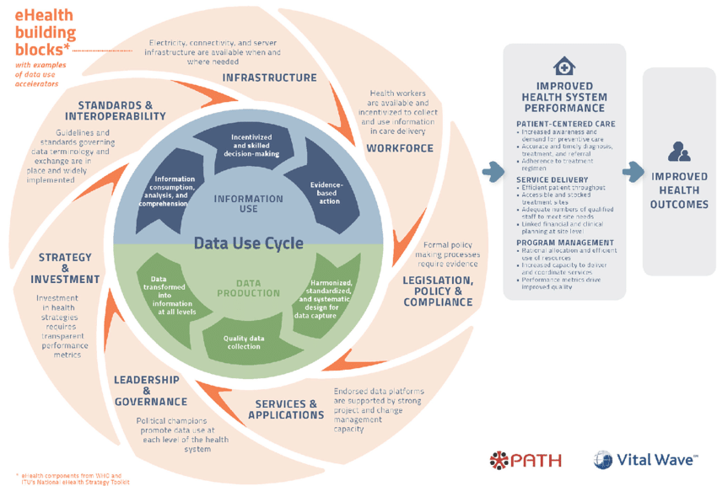
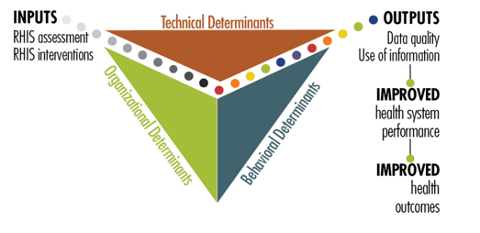
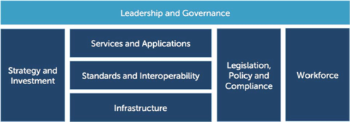
Existing models
DUALs work built upon existing normative guidance and models
Theory of Change for the Tanzania Data Use Partnership
Performance of Routine Information System Management Series (PRISM)
National eHealth Strategy Toolkit (WHO/ITU)
Notes:
Many current frameworks and models are often high level and do not account for country experiences and lessons.
Theory of Change for the Data Use Partnership. PATH, Vital Wave; 2016. PATH_DUP_Theory_of_Change_USletter_R2_static.pdf
Performance of Routine Information System Management Series (PRISM) Toolkit: MEASURE Evaluation.2019. https://www.measureevaluation.org/resources/tools/health-information-systems/prism
World Health Organization (WHO). National eHealth Strategy Toolkit. Geneva. 2012. https://www.itu.int/dms_pub/itu-d/opb/str/D-STR-E_HEALTH.05-2012-PDF-E.pdf

Slide 7
A collaborative research approach
Step 1
Conducted desk reviews and developed a research framework & methodology.
Step 2
Carried out key informant interviews and cross-country conversations.
Step 3
Held synthesis workshop to validate findings.
Step 4
Developed digital transformation model.
Step 5
Sharing country learnings with digital health stakeholders.
Photo: PATH/ Trevor Snapp
Notes:
Using qualitative analysis of documentation and interviews with key informants, DUAL determined interest in digital transformation and gathered evidence that would help to define lessons, best practices, and the critical factors that can support countries looking to increase use of data in decision-making within their health systems.

Slide 8
Research methodology
Phase 1 (completed)
A comprehensive document review helped to determine key themes within the current evidence base from our five focal countries.
Phase 2 (completed)
A qualitative assessment included KIIs, online surveys, and a series of webinars and virtual discussions with key representatives of our country audiences.
Gather
evidence
Phase 3 (completed)
An analysis of all five countries’ data helped to select themes for cross-country conversations after which the findings were compiled synthesis process. The DUAL model was developed.
Where are we now?
Engaging and building awareness of model with key stakeholders.
Notes:
DUAL consulted with a range of stakeholders to collect perspectives on digital health and data use programming and to gather evidence that would help to define lessons, best practices, and the critical factors that can support countries looking to increase use of data in decision-making within their health systems.
The lessons and experiences were refined into a model for digital transformation for data use.

Slide 9
A deeper dive
72 documents reviewed.
33 key informant interviews.
4 in-country conversations, 21 countries engaged across Africa, South America and Asia
1 synthesis workshop.
1 digital transformation model, 10 critical elements, 2 new elements
Notes:
Our research involved a comprehensive review of 72 documents including policies, project reports, health information systems documents, M&E reports, and more. We also did a qualitative assessment that included 33 key informant interviews, online surveys, and a virtual discussion with key representatives of our country audiences.
DUAL research was informed by ten digital transformation elements, adding two new components to the WHO-ITU eHealth Strategy building blocks: change management and data use ecosystems.

Slide 10
DUAL implementation framework
Leadership and governance
Services and applications
Committed leadership/champions
Multi-sector engagement
Governance structures
Applications
Technical support for systems
and users
Policy
Priority policy areas
Security standards, privacy and
confidentiality in data sharing, and
related legal frameworks
Workforce
Data and digital literacy/capacity
Motivation and incentives
Strategy
Cross-sectoral consensus building
National digital health strategy development
Socialization and implementation
Infrastructure
Physical infrastructure and system
Maintenance
Energy/electricity
Connectivity
Investment
Prioritization and costing of recommendations
National digital health investment roadmap
Country leadership of investment
Data use
ecosystem
Data collection/management
Feedback on data and data use
Data quality
Accessibility to relevant users
Incentivized and skilled decision-making
Value of data
Systems
architecture
Building country architect capacity
Standards and interoperability
Enterprise architecture
Change
management
Defining as-is and to-be state
Identifying and supporting champions
Facilitating feedback loops
Notes:
Key to this process has been the development of an implementation framework to inform the evidence gathering process and define the core components of a model for digital transformation for data use.
DUAL’s implementation framework focuses on all the components required to digitalize a health system—from the health workforce, to financing, and change management approaches—so that countries can adapt and apply lessons to their unique health landscapes.
The implementation framework was developed by reviewing common themes across 36 existing models, frameworks, and guidance documents related to data use, digital health, and health information systems to determine where there were commonalities and gaps.
We added two new components to the WHO-ITU eHealth Strategy building blocks: change management and data use ecosystems.

Slide 11
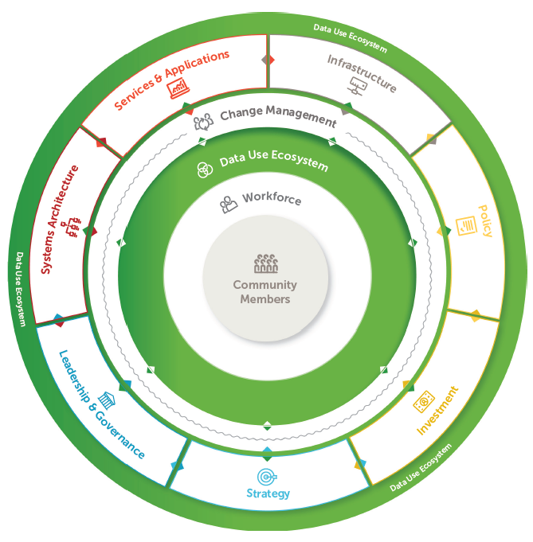
The DUAL model
The DUAL model identifies ten core elements of a comprehensive approach to transforming a country’s health data systems and digital tools to advance data use.
It builds on previous models and identifies two new elements: data use ecosystems and change management.
Notes:
The DUAL model evolves the World Health Organization (WHO) and International Telecommunication Union (ITU) eHealth Strategy Building Blocks. It’s key factors for success can be applied by countries at any stage in the process and will help to align financing, global policies, and future interventions.
Rather than presenting a linear, step-by-step guide for digital transformation, it provides the “ingredients” for success that depend on and enable one another toward catalytic change. Two of the newest elements identified by DUAL, include data use ecosystems and change management.
Data Use Ecosystem encompasses activities and motivations of health care workers that enable data-informed decision-making. This includes data
collection, management, analysis, and dissemination.
Change management is a set of interventions to support the successful adoption of new tools, practices, and procedures and achieve behavioral change and improvement in organizational performance.
Strategy - strategic planning for data use acceleration is the process of developing and aligning digital health plans and goals and planning for their implementation.
Systems architecture involves development of enterprise architecture using standards that optimize interoperability and enable digital health systems to increase the flow of data, hence improve data quality, access, and use. Developments in systems architecture are at the heart of digital health transformation efforts.

Slide 12
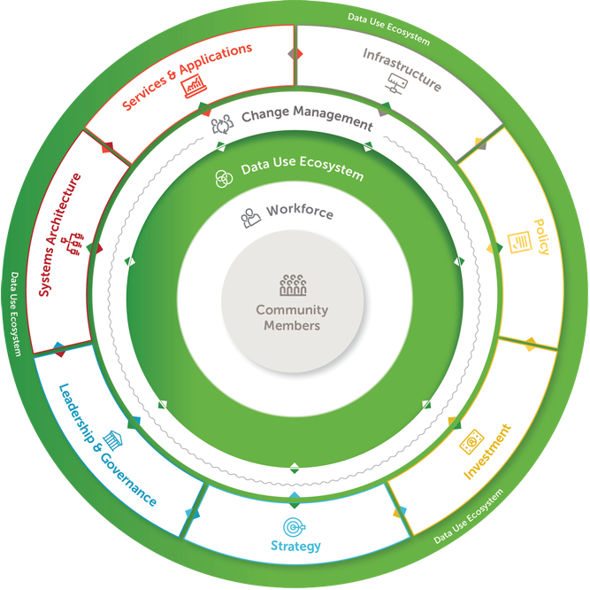
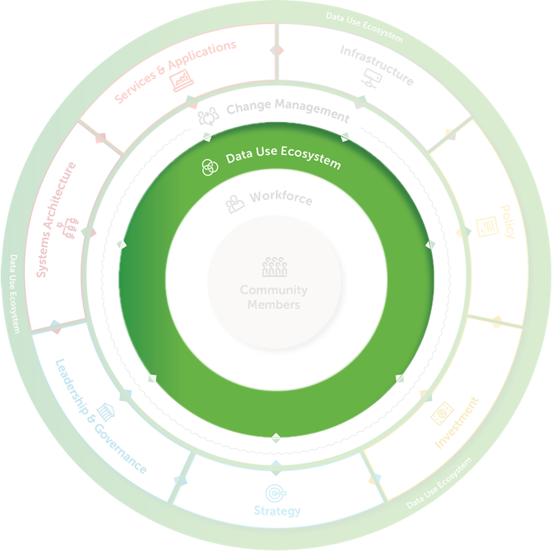
Data use ecosystem
A country’s digital ecosystem includes all aspects of data use and access. It requires strong systems architecture and interoperability so data can be collected, shared, and monitored across the health system.
Data use ecosystem is an important new element for digital transformation
Key factors
Ensure that data are collected, shared, and monitored across systems at all levels of the health system.
Focus on the use of data first, and data quality will follow.
Notes:
A robust data use ecosystem depends on a cohesive, aligned systems architecture in which systems can connect and share data collected from multiple sources. Without this architecture in place, data remain siloed, contributing to duplicative data collection efforts and incomplete data.
**Data Use ecosystem is DUAL’s newly identified core element.

Slide 13
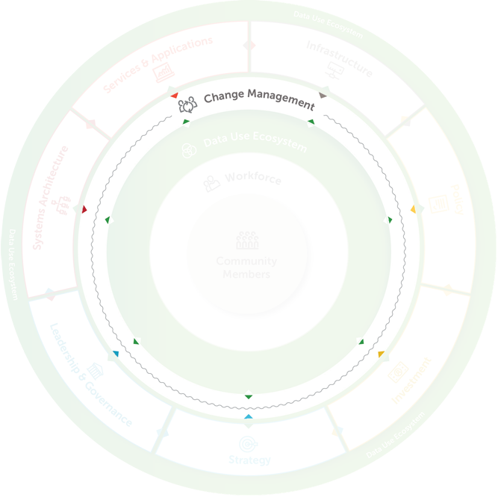
Change management
Change management strategies are critical for helping to evolve a country’s health system operations and workflows to support the adoption of new digital tools and approaches.
Key factors
Incorporate change management strategies targeting the health workforce into implementation plans.
Proactively raise awareness with leadership and key stakeholders to increase buy-in.
Notes:
While much work goes into planning the technical aspects of digital health transformations, often less consideration is given to how those changes will affect health workers. Change management, particularly around enforcing changes in standard operations, needs to be an integral part of digital health implementations, not an afterthought.
**Change management is DUAL’s newly identified core element.

Slide 14
Lessons learned
Leadership and governance
Services and applications
Adopt approaches that fit project goals.
Remain flexible to shifts in government.
Engage stakeholders within the health sector and beyond.
Policy
Build on existing health policies and standards.
Put in place governance structures.
Workforce
Increase data use at “lower levels,” including access to data and the skills to interpret data for daily use.
Strategy
Develop clear, long-term, and flexible plans and solutions.
Infrastructure
Rather than building for a “digital ideal,” consider ways to work with what is currently in place.
Investment
Ensure the alignment of investments.
Develop funding oversight mechanisms.
Data use
ecosystem
Strengthen data use culture at all levels.
Take a holistic approach.
Systems
architecture
Develop an implementation process and framework that uses “practical implementation” approaches.
Change
management
Consider political readiness and buy-in among senior leadership to drive change and increase uptake.

Slide 15
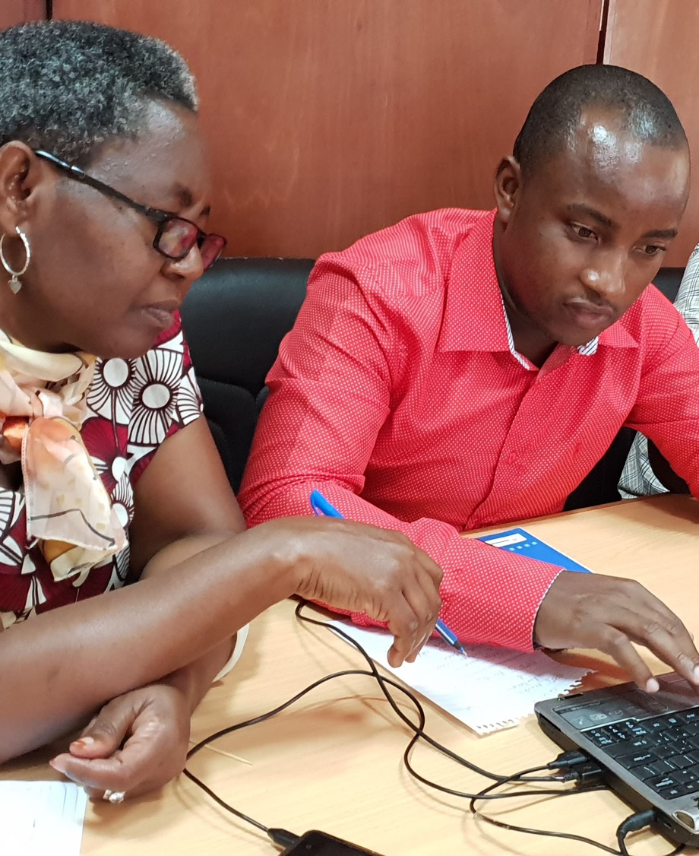
The DUAL model at work: Tanzania
Leadership and governance
Fostering digital champions both within and beyond the health sector
Implementing partners and the Ministry of Health established a project governance unit that engaged champions both within the Ministry of Health and beyond, helping to secure buy-in and create digital health advocates within various ministries and departments. This unit also included funder representation.
Photo: PATH
Notes:
DUAL element: Leadership and governance
Engaging multisectoral partners raises awareness of digital health interventions and increases their uptake.
Involve stakeholders in all stages of digital transformation: from strategic visioning to defining monitoring and evaluation (M&E) plans to sharing best practices.
In Tanzania, the governance unit helped to manage project work across multiple ministries and agencies.

Slide 16
Policy
The DUAL model at work: Burkina Faso
Building on existing policies and standards
The Ministry of Health defined a ten-year strategic plan for its National Health Information System based on existing policies evaluated by an implementation team. The Government is also using this evaluation to develop key five-year strategies.
Phot: PATH/ Trevor Snapp
Notes:
DUAL element: Policy
Information gleaned from the evaluation provided a comprehensive situational analysis on which to build the next five-year NHIS Strategic Plan and context to guide the development of other key strategies.
The government is using the evaluation results to draft key strategies for the next five years, including the NHIS 2021-2025 Strategic Plan, Digital Health Strategy, Health Sector Development Plan, and the National Economic and Social Development Strategy.

Slide 17
The DUAL model at work: South Africa
Strategy
Centering user needs in strategic planning and design
The implementation team hosted consortium meetings, stewarded by the government, to discuss the planning and implementation of digital solutions.
Photo: PATH
Notes:
DUAL element: Strategy
User-centered approaches varied across countries but included data user studies, focus groups with health care workers, and user advisory groups to test and iterate on new digital health systems. In this case, for example, the implementation team hosted consortium meetings, stewarded by the government, to discuss the planning and implementation of digital solutions. These meetings allowed technical staff and government officials to discuss new technologies in great depth and in a noncompetitive environment with peers who had strong on-the-ground and domain knowledge about the planning and implementation of digital solutions.

Slide 18
The DUAL model at work: Tanzania
Investment
Co-developing an investment roadmap
The implementation team partnered with the government to create the Digital Health Investment Roadmap (2017–2023).
This roadmap aligns digital health priorities for the country and gives recommendations for investment, as well as financing and cost guidelines.
Notes:
DUAL element: Investment
The roadmap helps to ensure that current and future digital health investments support Tanzania’s strategic vision for digital health while prioritizing finite resources.

Slide 19
The DUAL model at work: Burkina Faso
Services and applications
Harmonizing data collection systems
The implementation team is developing an inventory of all paper and digital health applications to better track, coordinate, and synchronize the various tools available to the health workforce helping to avoid duplication.
Photo: PATH/ Trevor Snapp
Notes:
DUAL element: Services and applications
The government is also conducting a metadata analysis and creating a data dictionary to define core data elements. Together, these activities will help find efficiencies and synergies in the country’s existing digital health systems.

Slide 20
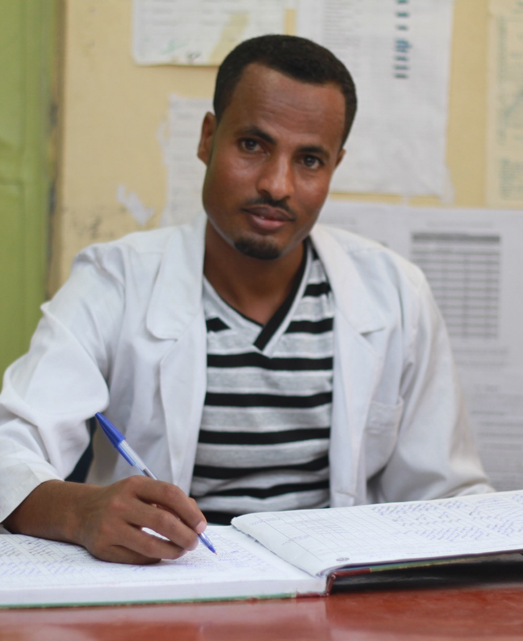
Workforce
The DUAL model at work: Ethiopia
Providing mentorship opportunities
The government launched a Capacity Building and Mentorship program with six universities, regional health bureaus, and other partners to further develop health worker and manager skills.
Photo: JSI
Notes:
DUAL element: Workforce
Address staffing challenges. Staffing challenges are often at the core of workforce barriers to using data and digital health systems. Staff who are overburdened or untrained will be disincentivized to use data.
The program with the six universities is designed to advance health worker and manager skills on an ongoing basis using new training manuals, technology courses, and other activities.

Slide 21
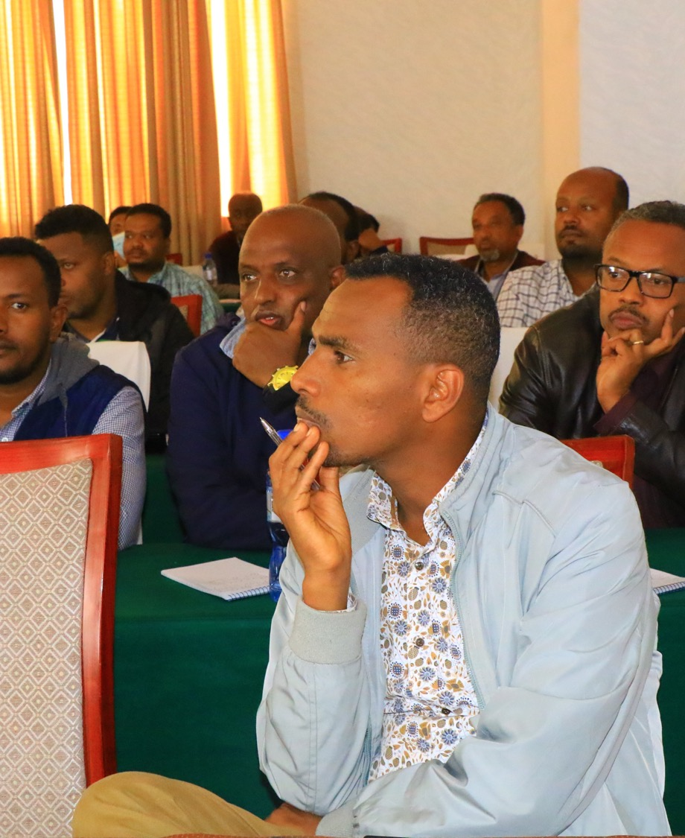
The DUAL model at work: Ethiopia
Infrastructure
Building technological and physical infrastructure
The implementation team partnered with the government to explore cloud-hosted alternatives for the country’s DHIS2 instance.
Photo: JSI
Notes:
DUAL element: Infrastructure
Since the DHIS2 systems needed consistent connectivity at all levels, the implementation team advocated for using cloud hosting services as part of the effort to enhance data use. Building the capacity of the Ministry of Health for cloud service optimization, real-time monitoring of performance, continuous data backup, and disaster recovery was crucial.

Slide 22
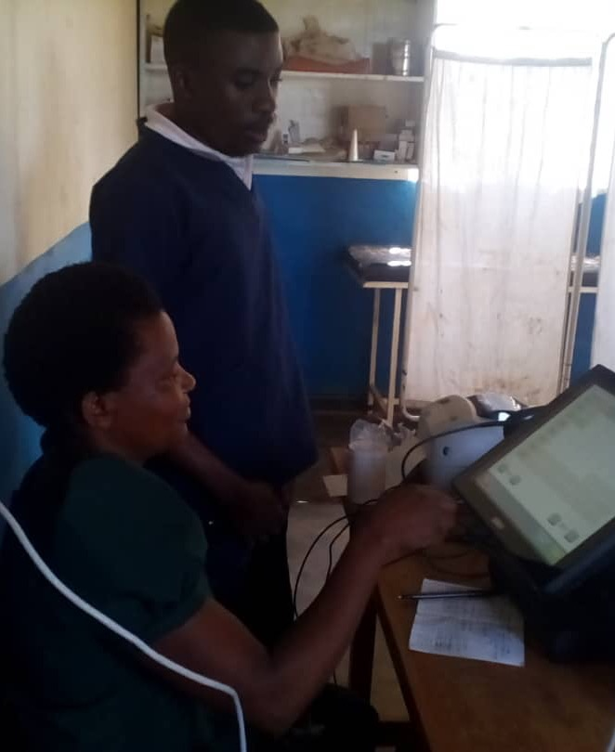
The DUAL model at work: Malawi
Systems architecture
Aligning national standards to local contexts
The implementation team partnered with the Ministry of Health to align national standards to district requirements. This enabled a more efficient systems architecture and created local ownership of the digital tools.
Photo: Cooper/Smith
Notes:
DUAL element: Systems architecture
The partnership in enabled a more efficient systems architecture and created local ownership of the digital tools.
Close cooperation with data users at the district and facility levels is needed to align their data requirements with national standards, resulting in a more efficient systems architecture. An added benefit is that more engagement at the lower levels leads to more local ownership of digital health systems.

Slide 23
Data use
The DUAL model at work: South Africa
Making data more visible and accessible to promote data use
A Provincial Health Data Centre was developed in Western Cape Province in which person-level data was harmonized based on unique patient identifiers.
Photo: PATH/ Trevor Snapp
Notes:
DUAL element: DATA USE
Making data available to health workers can kickstart a culture of data use and help solve issues with data quality. Countries learn in real-time how the health workforce uses data and where data quality issues are occurring toward an end goal of providing consistent, high-quality data.
The health data center in this case resulted in
Data being democratized, enabling greater data access and helping researchers conduct health-related research.
Data being in a single environment allowing for efficient data storage and dissemination.

Slide 24
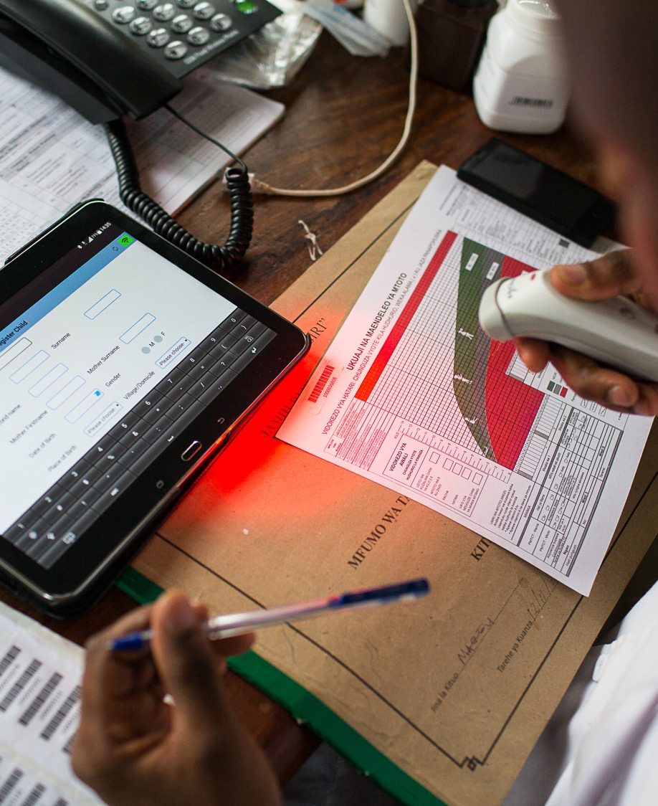
Change management
The DUAL model at work: Malawi
Data use campaigns for change management
The government introduced data use campaigns where health workers were trained to use DHIS2 dashboards and socialized on the different data use tools and systems available to them.
Photo: PATH
Notes:
DUAL element: Change management
Increase knowledge and understanding of data systems.
Changing existing views around digital technologies and how people engage with digital tools can be a challenge.
Many strategies can be employed to support change management and should be included in the digital health strategic plan. However, an understanding of the work culture where the changes occur is needed to tailor change management approaches that will yield the greatest results.

Slide 25
Cross-country findings
Engage stakeholders and develop digital health champions, including coordinating and aligning stakeholders.
In Ethiopia, implementation teams identified government champions to raise awareness of digital transformation activities. For example, the state minister’s office led the development of new standards, governance, and enforcement mechanisms for Ethiopia’s digital health systems, helping to build support at the highest levels of leadership.
Notes:
Champions within government for instance were seen as necessary allies in digital transformation activities who could provide a conduit to other leaders and rally stakeholders to advance project objectives.

Slide 26
Cross-country findings
Establish clear, strong governance structures appropriate to the country’s context and needs.
In Tanzania, implementing partners and the MoH established a project governance unit, which included funder representation, that manages work across multiple ministries and agencies. In addition, a National Digital Health Steering Committee, chaired by the permanent secretary of the MoH, oversees the national digital health strategy.
Ethiopia and Malawi both adopted an embedded approach that placed project implementation staff directly within government operations. This approach helped build champions within the MoH, determine processes for decision making, and coordinate digital projects and investments.
Notes:
A noted challenge to implementing new tools and applications was the lack of a governing body to oversee their review and approval and coordinate different projects.

Slide 27
Cross-country findings
Take user-centered design approaches, such as those used in human-centered design, to digital health tools and systems.
Malawi and Burkina Faso conducted data user studies to gain insight into user needs.
South Africa held consortium meetings, stewarded by the government, to discuss the planning and implementation of digital health solutions.
Tanzania used an “agile methodology” in their strategic planning efforts, working directly with users to develop systems and tools, which was viewed as critical for successful implementation.
Notes:
The approaches varied in the countries. The consortium meetings in South Africa, for instance, allowed technical staff and government officials to discuss new technologies with peers who had strong on-the-ground and domain knowledge.

Slide 28
Cross-country findings
Build workforce capacity and improve training of the health workforce.
Malawi launched a data use campaign to increase health workers’ access to data and their knowledge of data systems.
Ethiopia established a learning center where health workers could receive technical and professional support.
Malawi and Ethiopia used dashboards to improve data access and use for health workers.
Ethiopia and Tanzania worked with universities to develop and standardize training curricula for preservice and in-service training in HIS and data use.
Tanzania also updated its e-learning platform for in-service health workers in remote areas.
Notes:
Most of the five countries studied included some form of capacity building in their activities to improve use of digital tools and data by health workers. Again, different countries adopted a variety of approaches to accomplish this.

Slide 29
Cross-country findings
Ensure data are collected, shared, and monitored across systems
Tanzania developed a health enterprise architecture to serve as a conceptual blueprint for the structure and operation of the country’s digital health systems.
Ethiopia and in Burkina Faso inventoried digital health applications in use, which improved coordination among projects and helped avoid duplication of effort.
Malawi’s implementation team worked with the MoH to align national data standards and district-level requirements, which enabled a more efficient systems architecture.
Notes:
This was primarily done by establishing data standards, inventorying systems in use, and increasing the interoperability of different systems and tools.

Slide 30
Cross-country findings
Align funding
To help align funding and digital health priorities in Tanzania, the government created a digital health investment roadmap that recommended areas for investment as well as financing and cost guidelines.
For coordinating different investments, all five countries included donors in their stakeholder engagement to varying degrees.
Notes:
When donor coordination under a common plan or vision is lacking, donors contribute to the projects where they think they will get the greatest return on their investment; while these investments may be helpful, they may not align with achieving the country’s digital health plans.
Another strategy for coordinating different investments was to include funders and donors in technical working groups. All five countries included donors in their stakeholder engagement to varying degrees

Slide 31
Call to action: Country governments
Apply the DUAL model to digital transformation for data use efforts to align digital health initiatives and integrate the model’s key factors within national strategies.
Key actions to take:
Establish governance bodies to oversee and enforce digital health policies, guidelines, and standards.
Develop investment roadmaps to accurately budget and scope a national digital transformation for data use strategy.
Support existing technical working groups and committees in applying and institutionalizing digital health guidelines, systems, and tools that advance digital transformation.
Develop an enterprise architecture to define the current and future state of the national digital health system.
Increase coordination between sectors as well as regional, subnational, and national digital transformation efforts.
Notes:
Call to action: Country governments
Establish governance bodies to oversee and enforce digital health policies, guidelines, and standards.
Develop investment roadmaps to accurately budget and scope a national digital transformation for data use strategy.
Support existing technical working groups and committees in applying and institutionalizing digital health guidelines, systems, and tools that advance digital transformation.
Develop an enterprise architecture to define the current and future state of the national digital health system.
Increase coordination between sectors as well as regional, subnational, and national digital transformation efforts.
Use data, assessments, and evaluations to make digital transformation investment and programmatic decisions.
Build multiuse digital health systems and tools that can be applied across different scenarios, uses, and landscapes (as appropriate), rather than rebuilding applications for every new environment.
Design digital and data tools that are responsive to infrastructure challenges and limitations.
Cultivate champions at all levels of the government and within other relevant sectors to advocate for digital transformation for data use.
Motivate and empower health workers to use and act on data, rather than just serving as data collectors.
Identify and build the capacity of health actors at all tiers of the health system to model and cultivate a culture of data use.
Develop long-term, country-generated funding streams to finance the real and ongoing costs of digital and data infrastructure.

Slide 32
Call to action: Country governments (continued)
Apply the DUAL model to digital transformation for data use efforts to align digital health initiatives and integrate the model’s key factors within national strategies.
Key actions to take:
Use data, assessments, and evaluations to make digital transformation investment and programmatic decisions.
Build multiuse digital health systems and tools that can be applied across different scenarios, uses, and landscapes (as appropriate), rather than rebuilding applications for every new environment.
Cultivate champions at all levels of the government and within other relevant sectors to advocate for digital transformation for data use.
Design digital and data tools that are responsive to infrastructure challenges and limitations.
Motivate and empower health workers to use and act on data, rather than just serving as data collectors.
Notes:
Call to action: Country governments
Establish governance bodies to oversee and enforce digital health policies, guidelines, and standards.
Develop investment roadmaps to accurately budget and scope a national digital transformation for data use strategy.
Support existing technical working groups and committees in applying and institutionalizing digital health guidelines, systems, and tools that advance digital transformation.
Develop an enterprise architecture to define the current and future state of the national digital health system.
Increase coordination between sectors as well as regional, subnational, and national digital transformation efforts.
Use data, assessments, and evaluations to make digital transformation investment and programmatic decisions.
Build multiuse digital health systems and tools that can be applied across different scenarios, uses, and landscapes (as appropriate), rather than rebuilding applications for every new environment.
Design digital and data tools that are responsive to infrastructure challenges and limitations.
Cultivate champions at all levels of the government and within other relevant sectors to advocate for digital transformation for data use.
Motivate and empower health workers to use and act on data, rather than just serving as data collectors.
Identify and build the capacity of health actors at all tiers of the health system to model and cultivate a culture of data use.
Develop long-term, country-generated funding streams to finance the real and ongoing costs of digital and data infrastructure.

Slide 33
Call to action: Policymakers
Champion the DUAL model and develop policies and guidance in accordance with its recommendations
Key actions to take:
Develop guidance for and promote adoption of two new elements — data use ecosystems and change management.
Use evidence generated from country implementations to define policies and guidance.
Encourage development of investment roadmaps at the country level to accurately budget and scope digital transformation for data use strategies.
Notes:
Call to action: Country governments
Establish governance bodies to oversee and enforce digital health policies, guidelines, and standards.
Develop investment roadmaps to accurately budget and scope a national digital transformation for data use strategy.
Support existing technical working groups and committees in applying and institutionalizing digital health guidelines, systems, and tools that advance digital transformation.
Develop an enterprise architecture to define the current and future state of the national digital health system.
Increase coordination between sectors as well as regional, subnational, and national digital transformation efforts.
Use data, assessments, and evaluations to make digital transformation investment and programmatic decisions.
Build multiuse digital health systems and tools that can be applied across different scenarios, uses, and landscapes (as appropriate), rather than rebuilding applications for every new environment.
Design digital and data tools that are responsive to infrastructure challenges and limitations.
Cultivate champions at all levels of the government and within other relevant sectors to advocate for digital transformation for data use.
Motivate and empower health workers to use and act on data, rather than just serving as data collectors.
Identify and build the capacity of health actors at all tiers of the health system to model and cultivate a culture of data use.
Develop long-term, country-generated funding streams to finance the real and ongoing costs of digital and data infrastructure.

Slide 34
Call to action: Funders
Champion the DUAL model and invest in programming that reflects its findings and
recommendations.
Key actions to take:
Ensure digital health investments align with countries’ vision and strategies.
Work with other funders to align investments and harmonize with country priorities for digital transformation to reduce the burden on countries and implementing partners.
Invest in foundational country-led activities to lay the groundwork for sustainable, long-term digital transformation, including the development of:
National-level digital health strategies and roadmaps;
Policies to support digital transformation for data use;
Governance mechanisms to enforce new digital health policies, guidelines, and standards; and
Enterprise architecture to define the current and future state of the national digital health system.
Identify the true costs of digital and data infrastructure and work with country governments to determine sustainable funding streams.
Notes:
Call to action: Country governments
Establish governance bodies to oversee and enforce digital health policies, guidelines, and standards.
Develop investment roadmaps to accurately budget and scope a national digital transformation for data use strategy.
Support existing technical working groups and committees in applying and institutionalizing digital health guidelines, systems, and tools that advance digital transformation.
Develop an enterprise architecture to define the current and future state of the national digital health system.
Increase coordination between sectors as well as regional, subnational, and national digital transformation efforts.
Use data, assessments, and evaluations to make digital transformation investment and programmatic decisions.
Build multiuse digital health systems and tools that can be applied across different scenarios, uses, and landscapes (as appropriate), rather than rebuilding applications for every new environment.
Design digital and data tools that are responsive to infrastructure challenges and limitations.
Cultivate champions at all levels of the government and within other relevant sectors to advocate for digital transformation for data use.
Motivate and empower health workers to use and act on data, rather than just serving as data collectors.
Identify and build the capacity of health actors at all tiers of the health system to model and cultivate a culture of data use.
Develop long-term, country-generated funding streams to finance the real and ongoing costs of digital and data infrastructure.

Slide 35
Call to action: Funders (continued)
Champion the DUAL model and invest in programming that reflects its findings and
recommendations.
Key actions to take:
Advocate for countries to establish governance bodies to oversee digital transformation for data use.
Invest in global goods, standards, and interoperable systems instead of standalone systems.
Leverage data, assessments, and evaluations to make investment decisions.
.
Invest in building the capacity of health actors at all tiers of the health system to model and cultivate a culture of data use.
Encourage user-centered design and interoperability during the development of digital health systems.
Notes:
Call to action: Country governments
Establish governance bodies to oversee and enforce digital health policies, guidelines, and standards.
Develop investment roadmaps to accurately budget and scope a national digital transformation for data use strategy.
Support existing technical working groups and committees in applying and institutionalizing digital health guidelines, systems, and tools that advance digital transformation.
Develop an enterprise architecture to define the current and future state of the national digital health system.
Increase coordination between sectors as well as regional, subnational, and national digital transformation efforts.
Use data, assessments, and evaluations to make digital transformation investment and programmatic decisions.
Build multiuse digital health systems and tools that can be applied across different scenarios, uses, and landscapes (as appropriate), rather than rebuilding applications for every new environment.
Design digital and data tools that are responsive to infrastructure challenges and limitations.
Cultivate champions at all levels of the government and within other relevant sectors to advocate for digital transformation for data use.
Motivate and empower health workers to use and act on data, rather than just serving as data collectors.
Identify and build the capacity of health actors at all tiers of the health system to model and cultivate a culture of data use.
Develop long-term, country-generated funding streams to finance the real and ongoing costs of digital and data infrastructure.

Slide 36
Call to action: Implementers
Apply the DUAL model to current and future projects to optimize the impact of digital and data interventions.
Key actions to take:
Ensure digital health activities are government-driven by aligning to country strategies, policies, and health visions.
Apply user-centered design approaches to develop interoperable digital health systems.
Build the capacity of health actors at all tiers of the health system to model and cultivate a culture of data use.
.
Work within existing governance bodies, technical working groups, and committees to ensure buy-in for and support the design of digital and data initiatives.
Build multiuse digital health systems and tools that can be applied across different scenarios, uses, and landscapes (as appropriate), rather than rebuilding applications for every new environment.
Notes:
Call to action: Country governments
Establish governance bodies to oversee and enforce digital health policies, guidelines, and standards.
Develop investment roadmaps to accurately budget and scope a national digital transformation for data use strategy.
Support existing technical working groups and committees in applying and institutionalizing digital health guidelines, systems, and tools that advance digital transformation.
Develop an enterprise architecture to define the current and future state of the national digital health system.
Increase coordination between sectors as well as regional, subnational, and national digital transformation efforts.
Use data, assessments, and evaluations to make digital transformation investment and programmatic decisions.
Build multiuse digital health systems and tools that can be applied across different scenarios, uses, and landscapes (as appropriate), rather than rebuilding applications for every new environment.
Design digital and data tools that are responsive to infrastructure challenges and limitations.
Cultivate champions at all levels of the government and within other relevant sectors to advocate for digital transformation for data use.
Motivate and empower health workers to use and act on data, rather than just serving as data collectors.
Identify and build the capacity of health actors at all tiers of the health system to model and cultivate a culture of data use.
Develop long-term, country-generated funding streams to finance the real and ongoing costs of digital and data infrastructure.

Slide 37
Call to action: Cross-cutting
To engage stakeholders and improve leadership:
Country governments can form technical working groups across sectors; and
Country governments can cultivate digital health champions at all levels of the health system.
To improve design of health systems:
Country governments can advocate for building systems and tools that are responsive to infrastructure limitations and challenges;
Implementers can apply user-centered design approaches when developing digital health systems;
Implementers can build multiuse systems rather than designing separate systems for each use case; and
Funders can invest in global goods, standards, and interoperable systems instead of standalone systems.
Notes:
We recommend the following actions that stakeholders can take to improve their digital transformation efforts

Slide 38
Call to action: Cross-cutting
To build health workforce capacity for using digital tools and systems and the data they produce:
Country governments and implementers can build the capacity of health workers at all levels through training, professional development, mentoring, and other proven practices;
To strengthen governance structures:
Country governments can establish governance bodies to establish, manage, and enforce digital health policies, guidelines, and standards;
Motivate and empower health workers to use and act on data, rather than just serving as data collectors;
Identify and build the capacity of health actors at all tiers of the health system to model and cultivate a culture of data use; and,
Funders can invest in these capacity-building efforts
Implementers can ensure that digital health activities are government driven and work within existing governance structures (such as technical working groups, steering committees, etc.); and,
Funders can advocate for countries to establish necessary governance bodies.
Notes:
We recommend the following actions that stakeholders can take to improve their digital transformation efforts

Slide 39
Call to action: Cross-cutting
To increase evidence-based planning:
Policymakers can use evidence to inform new and revised policies and guidance for digital health;
To align and sustain funding efforts:
Country governments can develop investment roadmaps and long-term funding streams;
Funders can leverage data, assessments, and system evaluations to inform investment decisions; and,
Funders can contribute to the existing evidence base.
Policymakers can encourage country development of investment roadmaps;
Funders can ensure investments align with countries’ visions and strategies;
Funders can work with other funders to harmonize with country priorities and reduce the burden on countries;
Funders can invest in foundational country-led activities; and,
Funders can identify the true costs of digital and data infrastructure to help determine sustainable funding streams.
Notes:
We recommend the following actions that stakeholders can take to improve their digital transformation efforts

Slide 40
Resources available on the DUAL website
Full DUAL report
Factsheets
Slides
Case studies
FAQs
https://www.acceleratedatause.org

